Slide 1
REST API
Notes:
Deel scherm!

Slide 2
REST API model
Rest api model
Client App
Any Language
Request data, server format
Server App
In AIMMS
Response data, server format
Notes:
1999 – two decades
Een text interface – maar geen com / .net / jvm / … interface:
Server determines interface – (Client adheres to published interface from server)
Client and Server – both in “any language”
→ An opportunity (kans) and a concern (punt van zorg).

Slide 3
Opportunity AIMMS App
Opportunity AIMMS App
AIMMS Published App
Server App
Dex Provider
Client App
Dex Client
Exposing Service
Deploying Service
Notes:
Een AIMMS app kan zowel een provider als een consumer zijn.

Slide 4
Opportunity AIMMS App
Opportunity AIMMS App
AIMMS Published App
Server App
Dex Provider
Client App
Dex Client
Exposing Service
Deploying Service
Notes:
Een AIMMS app kan zowel een provider als een consumer zijn.

Slide 5
Well actually …
An AIMMS app can be a node in a network of services.
AIMMS Published App
Client of Several Services
Exposed to Several Clients
Notes:
Een AIMMS app kan een node in een network zijn:
0, 1, of meerdere klanten
0, 1, of meerdere services gebruiken.

Slide 6
Well actually …
An AIMMS app can be a node in a network of services.
AIMMS Server App
Client of Several Services
Exposed to Several Clients
Notes:
Een AIMMS app kan een node in een network zijn:
0, 1, of meerdere klanten
0, 1, of meerdere services gebruiken.

Slide 7
OpenAPI → Generated Client Calls
AIMMS Client App
Server ABC
AIMMS Application data structures (algebraic notation)
1
Request data, AIMMS format
OpenAPI Server ABC
Generated AIMMS Library
Request data, server format
2
4
Response data, AIMMS format
3
Response data, server format
Generated calls
Notes:
Jump in presentation.
First view slide 2, now addressing concern.
Which problem am I solving: putting AIMMS Identifiers in a file/memory stream according to some format, calling, getting response – handling response, when correct, when incorrect.
Much easier, if the server would just use AIMMS Identifiers, wouldn’t it?
Well with a library generated based on an OPENAPI spec, we seemingly achieve this ease.

Slide 8
Recap REST API
Dimensions:
Perspectives
Consumer (support building clients)
Provider (support building servers)
REST API (started 1999)
Vintage (clients and servers) supported
Modern (clients and servers) leveraged

Slide 9
Demo overview
Consumer – Hello World
Create OPENAPI Library
Use AIMMS OPENAPI library for User Management
Present creating Provider
C++ Client of AIMMS Provided Service
AIMMS Client of AIMMS Provided Service
Notes:
6 presentaties – hoeveel tijd hebben we?

Slide 10
Consumer – Hello World
Demo: ConsumeURL
First drop down to quo mare.
Enter erroneous URL
Show code:
Enter URL to https://chriskuip.aimms.cloud/pro-api/v1?apiFormat=JSON
Link to next slide: show in swagger.
Notes:
1: Start AIMMS 4.89 app in: C:\u\s\nirvana\0230 cloud and rest api\0230 consumer hello world\0230-consumer-hello-world\app\ConsumeURL
2: Error URL: for instance https://mybad.com (may take a minute or so to determine it doesn’t exist)
Remark: better error handling will be shown later.
3: Show code: goto first demo bookmark and discuss.

Slide 11
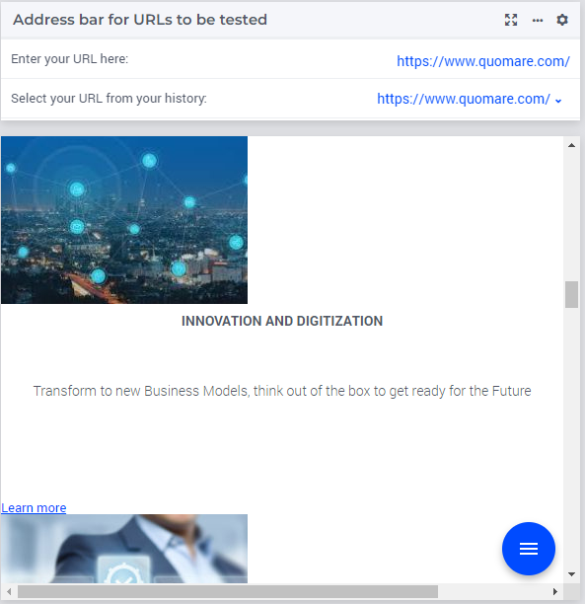
Front page Quo Mare in iFrame widget

Slide 12
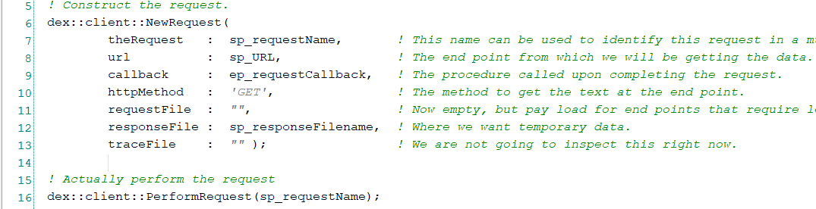
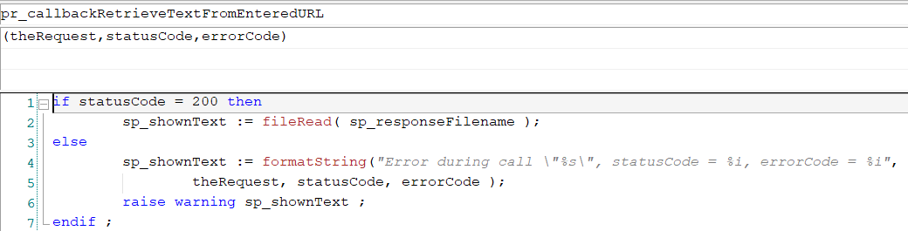
Code Fragments
Code fragments

Slide 13
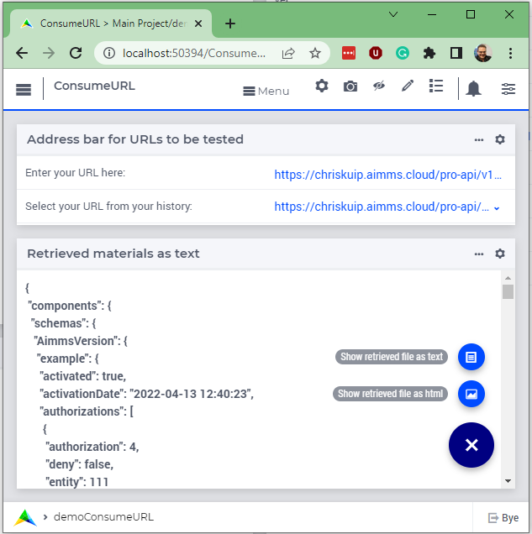
Download an OPENAPI
Download an openAPI

Slide 14
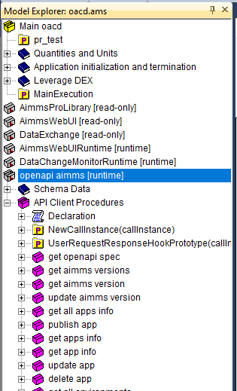
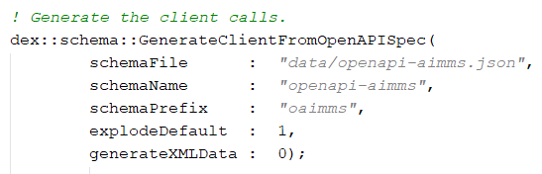
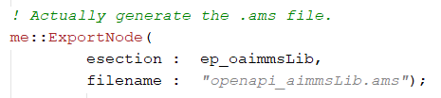
Openapi client call library – step 1: generation
Create openapi client calls
Don’t forget to copy the ./Mappings/Generated/*.xml mapping files!
Notes:
* 1. Show generating OPENAPI bieb code.

Slide 15
Openapi client call library – step 2: leverage: User Management
Read Environments – no apiKey needed
Read users and groups – apiKey needed, where do I get it?
Demo obtain API key.
Demo time (show data read in, show parallel)
Other authorizations – available in DEX, not in this Demo.
Adding a user, new user
Adding a user, existing user → error handling.
Demo time (show success, show failure)
Notes:
* Demo app in C:\u\s\nirvana\0230 cloud and rest api\0230 user management\0230-user-mngt-rest-api\app\UserManagement

Slide 16
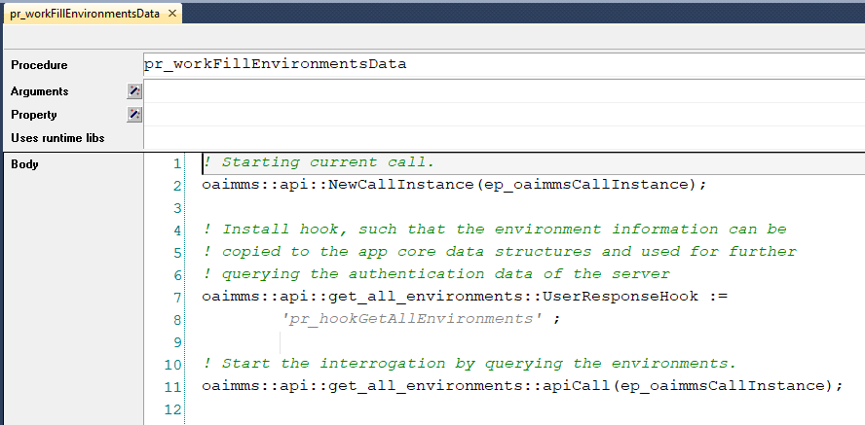
Code get 1
Code 1

Slide 17
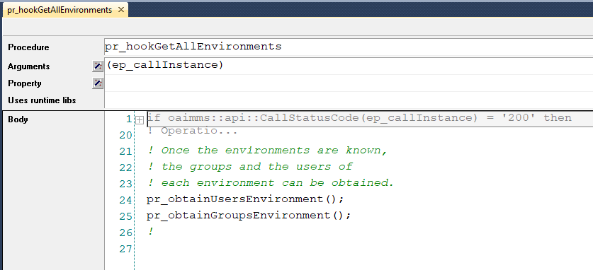
Code get 2
Note that for 2 environments, both the users and the groups are requested.
In other words, four requests can be active at the same time.

Slide 18
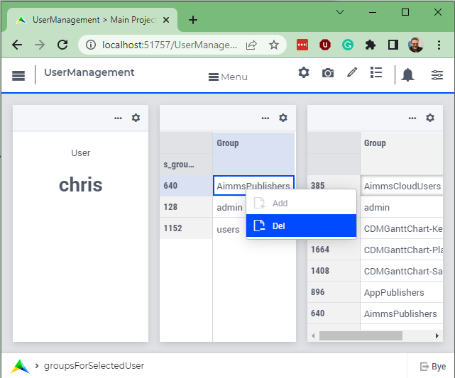
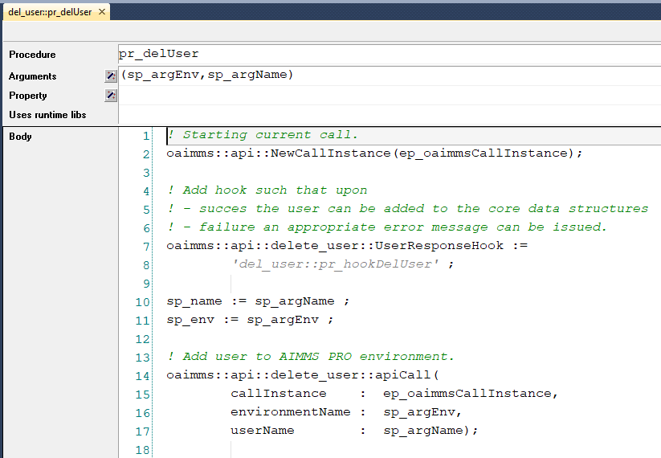
Opening User Management, delete group for user
Overview

Slide 19
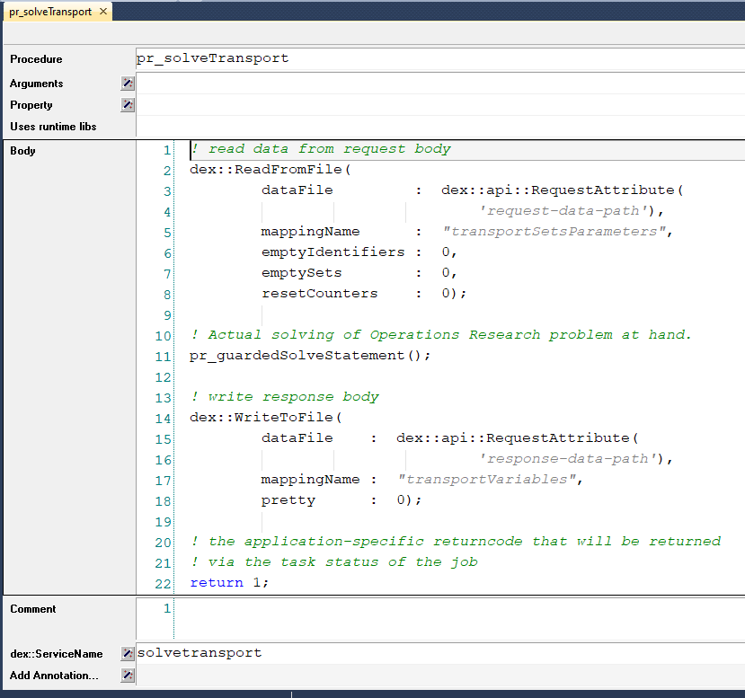
Creating Provider
Mark procedure
Specify input handling
Specify result handling

Slide 20
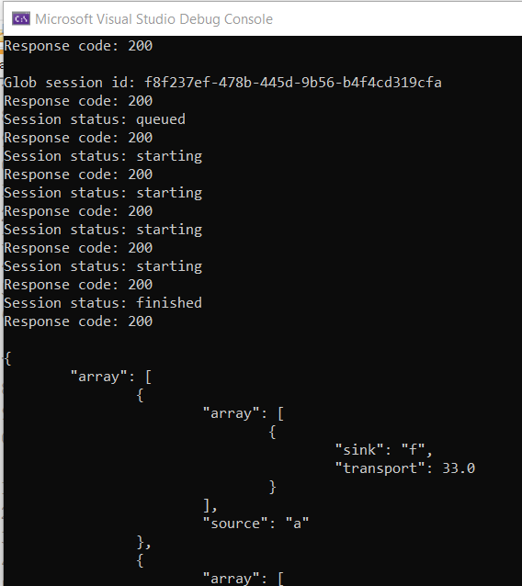
C++ Client of created provider
C++ Client of created provider
Directly on Curl
No parallelism used.

Slide 21
AIMMS Client of Created Provider
AIMMS Client of Created Provider

Slide 22
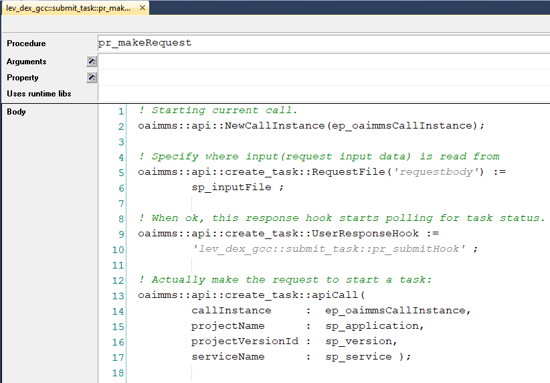
Start task
Request body specified, otherwise normal spec of request.

Slide 23
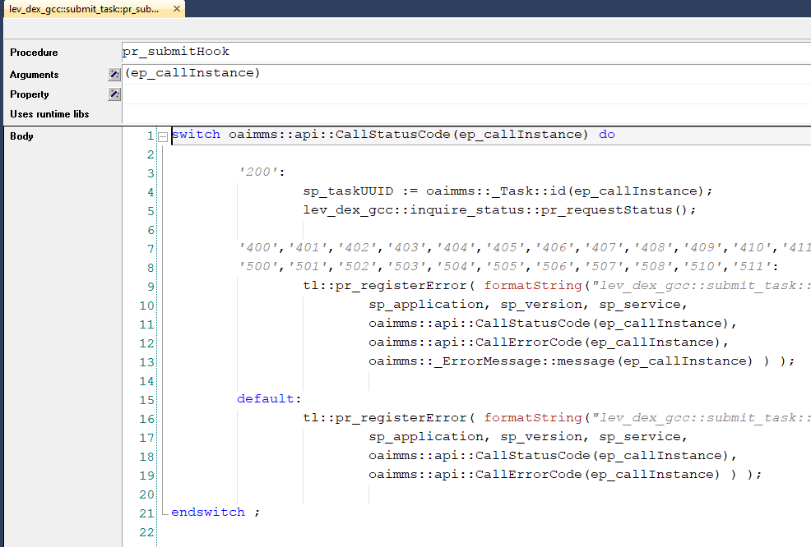
Submit hook
200: (happy flow) first copy task ID from lib, then continue interaction

Slide 24
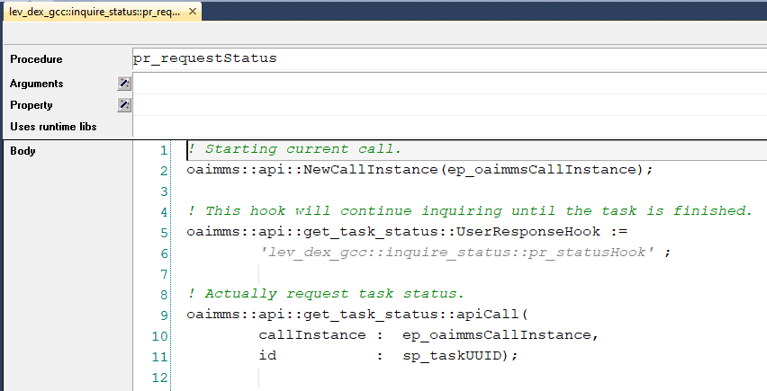
3 reg stat
Req stat
Follows basic pattern.

Slide 25
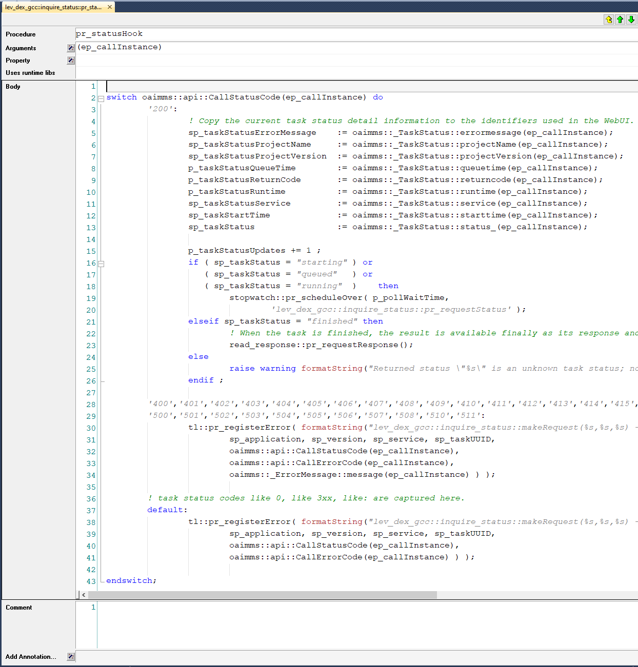
4 status hook
4 status hook

Slide 26
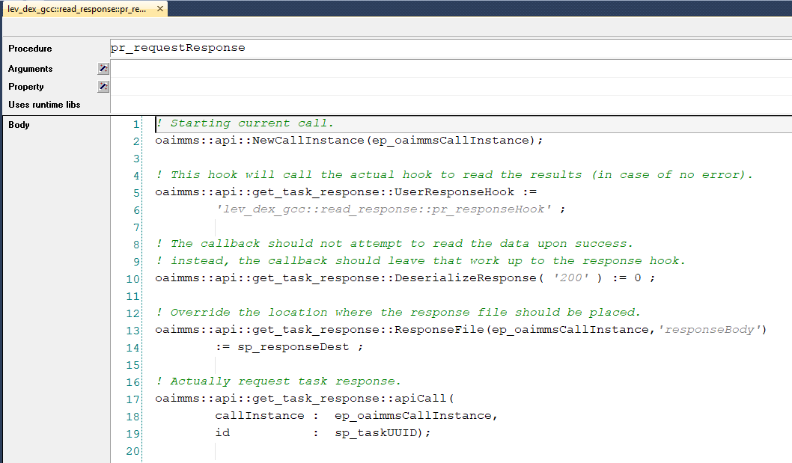
5 response
5 response
Deserialize
Response dest

Slide 27
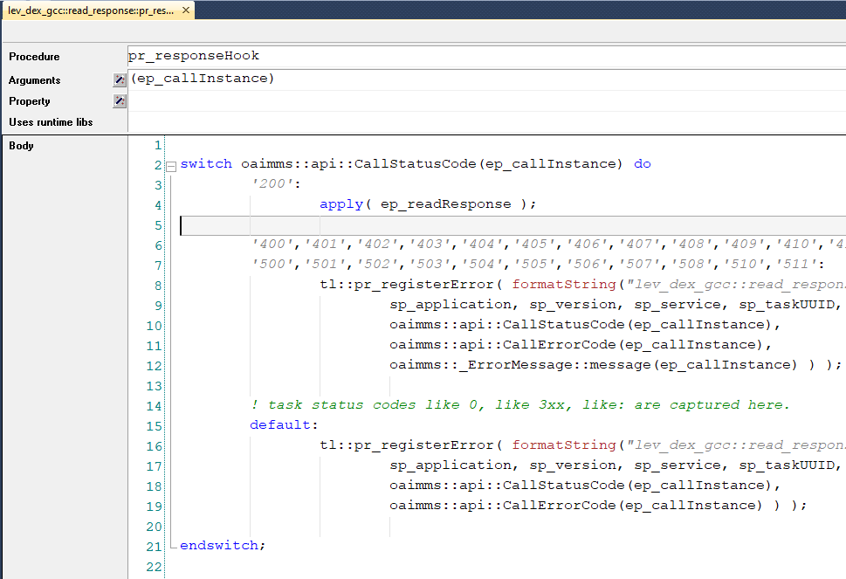
6 response hook
Response hook
Interesting line 4.

